Slide 1
Topic: Scale Drawings
EQ: How do I interpret House Plans?

Slide 2

From Last Lesson

Slide 3

24
7
30
House Plans
Date
EQ – How do we interpret house plans?
What is a house plan?
Each building must have plans drawn up before it can be build. These scale diagrams are called house plans
House plans use many symbols and abbreviations
Most house plan measurements are shown in millimetres to avoid using a decimal point, which can lead to errors in printing
House plans are also used to work out
how much materials are needed to
decorate the room or house

Slide 4


Slide 5
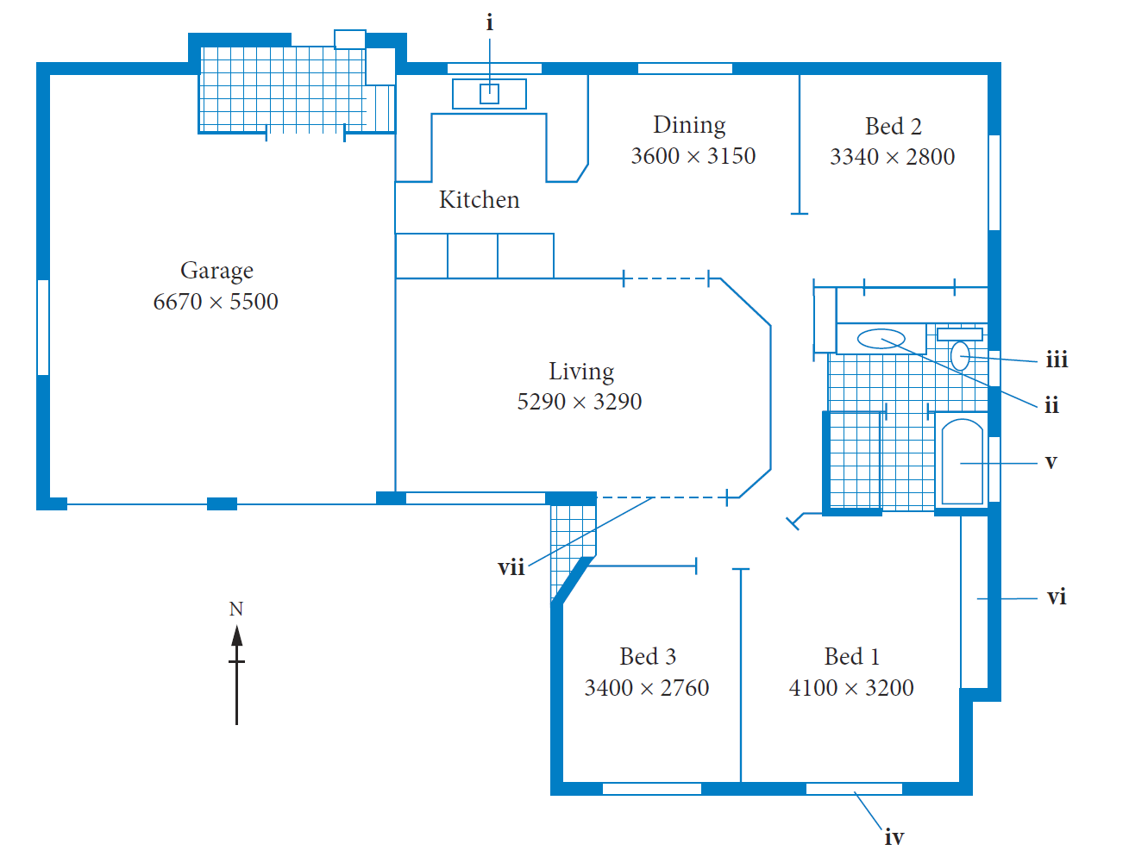
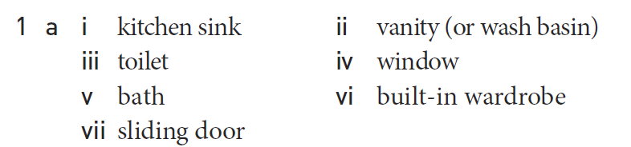
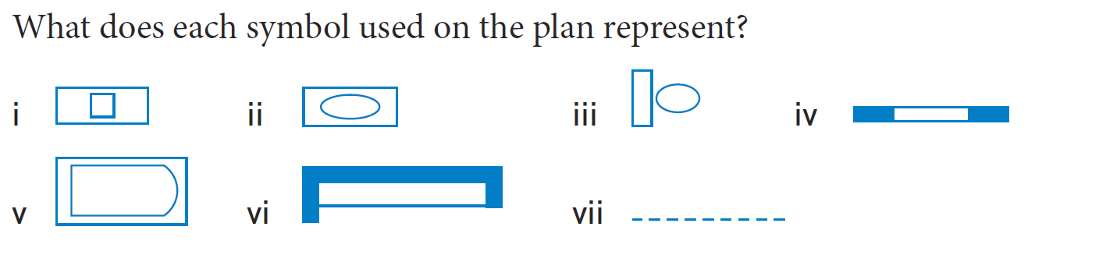
Practice

Slide 6
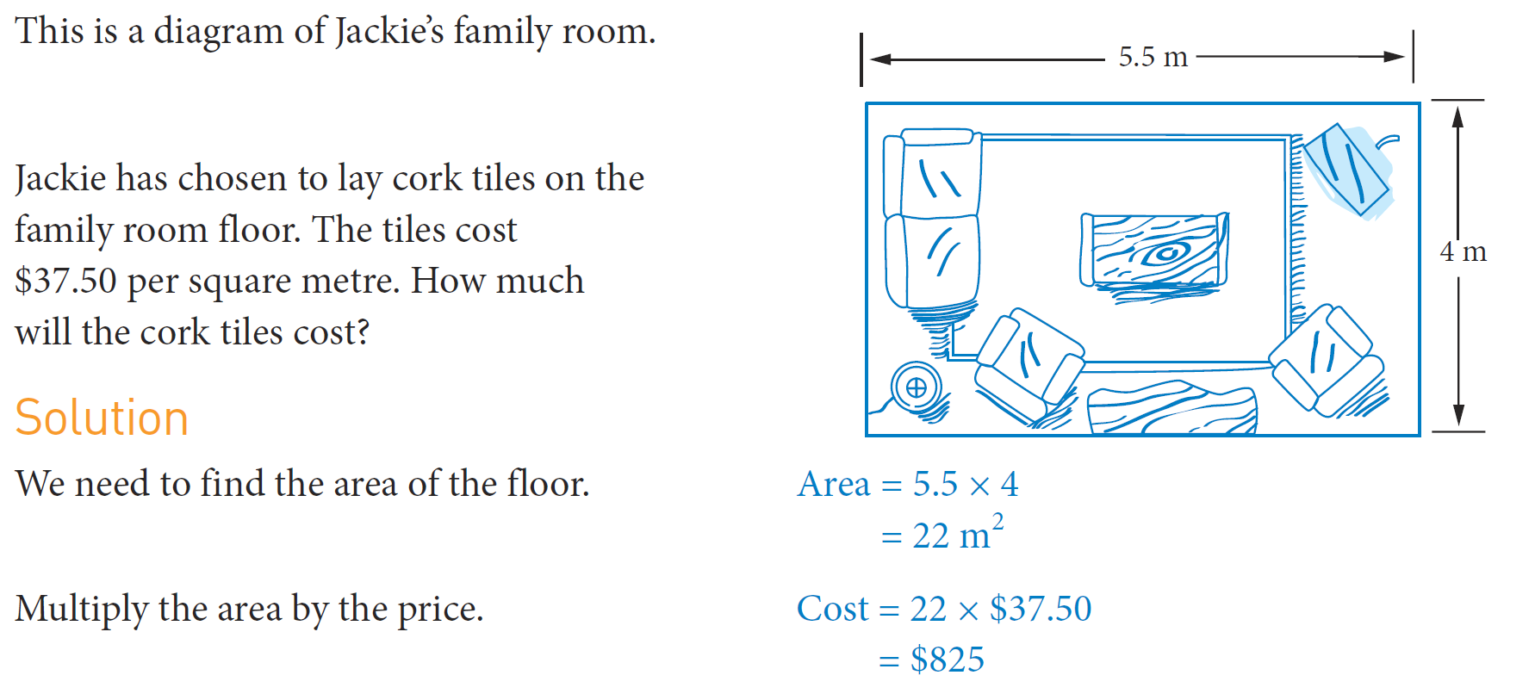
Practice

Slide 7
Task
Interpreting an office plan Worksheet

